Slide 1
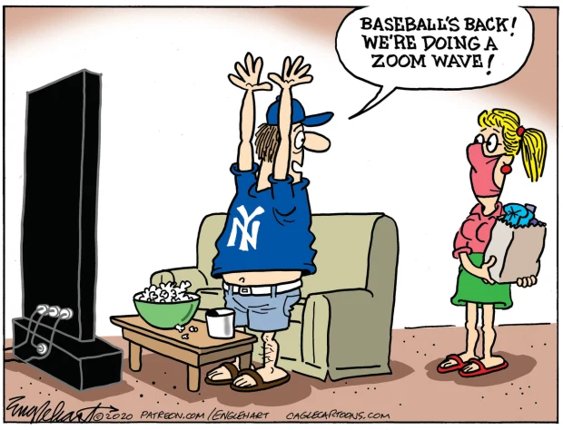
Staff Senate
Meeting
October 1, 2020

Slide 2
OUHSC Staff Senate
Business
Call to Order time
June, August and September minutes sent via email to Senators for approval. All minutes approved without changes as of 9/30/20.

Slide 3
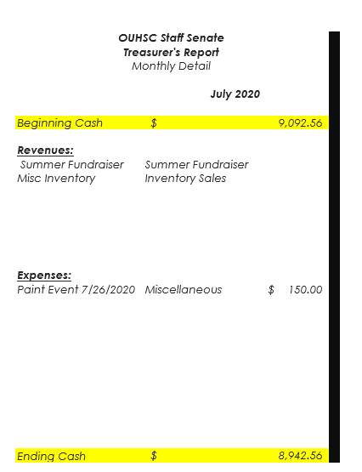
Executive committee
Treasurer’s Report
JULY report
Due to the upgrade of PeopleSoft system, our August report is still open. The previously approved/shared report can be found on the Staff Senate Website.
2020-2021 Meeting Archive-
June 18th 2020 minutes
Senator quorum VOTE needed for July report

Slide 5
Committee on committees
At this time, all committees have full rosters.
Senator report
1 current Senator vacancy- College of Medicine
Welcome New Senators
Sharon Vasquez- College of Nursing, Group 4
Wanda Felty- Centers of Excellence, Group 10
Carol Clure 271-2054 Carol-Clure@ouhsc.edu
Will Andrews x36121William-Andrews@ouhsc.edu

Slide 6
Communication committee
Meetings will be held on the 3rd Thursday of each month.
Communication Committee met via email in September.
The HSC Communication Committee will continue to be the point for updates to social media, the HSC Staff Senate website, and email. The team works with other SS committees to highlight the efforts, events, outreach, and updates related to HSC Staff Senate. For the latest Staff Senate Updates, follow them at:
Facebook.com/OUHSCStaffSenate

Slide 7
Community outreach committee
Meet the 4th Tuesday of every month via Zoom from 10-11am
In October we will be highlighting and thanking Employee Health (the whole team) for their service everyday and especially during the pandemic. We are collecting bags of Halloween Candy, healthy snacks, etc. starting October 1. If you wish to donate money, candy or items, please contact Jennie Robison or Kyndall Wahkinney.
Jennie-Robison@ouhsc.edu or Kyndall-Wahkinney@ouhsc.edu

Slide 8
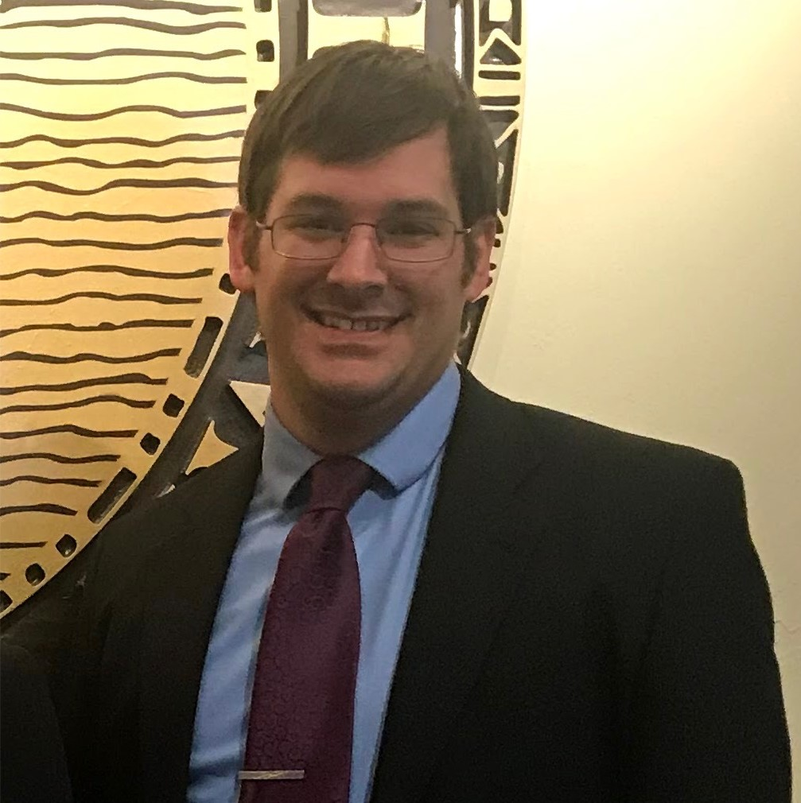
Employee of the Month
OCTOBER 2020
Joseph Schmidt
HSC Student Affairs

Slide 9
Employee of the month committee
Eligibility- FT, Non faculty appt. Worked at least 5 consecutive calendar years.
3 letters of support from OUHSC personnel (one from direct supervisor)
Nominee must not have received the Employee of the Month award in the past five years.
Complete eligibility and details can be found on our Staff Senate website.

Slide 10
Fundraising COMMITTEE
Committee meets the 4th Wednesday of the month at 10:30 a.m. via ZOOM. Also does business via email.
  The fundraising committee is working to launch the Holiday Fundraiser by October 8th. This will include a few different items that can be ordered online and sent directly to your home or the home of your recipient if purchasing as a gift.
  Bedlam t-shirts will be available and they are for all Bedlam sports. They will be delivered in time for the November 21st Bedlam football game, but would make great gifts for fans of all Bedlam sports.
  See’s Candies and Crockstar Dinner Club will also be available to help with your holiday preparations.
  Shop early! Items will sell out quickly this year!

Slide 11


STAFF SENATE FUNDRAISER
COMING SOON
Sale Starts October 8th!
Crockstar Dinner Club
Bedlam T-shirts
See’s Candies
Paula Cockrell – Committee Chair

Slide 12
Staff EVENTS Committee
Meets the 3rd Wednesday of the month via ZOOM.
1st meeting held on September 23rd. Currently working on event for late October. More details to come.

Slide 13
New business and announcements
THE FOLLOWING SLIDES ARE THE UPCOMING EVENTS FOR OUHSC
IF YOUR DEPARTMENT WOULD LIKE AN EVENT FEATURED HERE – PLEASE EMAIL Nancy-Geiger@ouhsc.edu

Slide 14
Mobile Market Volunteers needed
Educational and family task force
In partnership with OUHSC, OU Medicine, St. Luke's and Regional Food Bank of Oklahoma, we are launching a Mobile Market available to all members of the OU community. This Mobile market will distribute Food Packs on Thursdays from *11:30-1pm in designated campus locations.
Our Community Outreach Committee has staffed the October volunteer slots. Kelli Walsh will be organizing volunteers for the November and December months. If you are interested in volunteering please contact Kelli-walsh@ouhsc.edu
*times may vary slightly should they add additional sites.

Slide 15

2021 BeNEFITS
Open Enrollment
October 19- November 6, 2020

Slide 16
Notable Benefits changes coming in 2021
OUHSC will continue on the Blue Cross Blue Shield Medical Plan
Replace Delta Dental with Blue Cross Blue Shield Dental
Replace VSP vision insurance with MetLife
Updated salary bands in the 3 Tier model
New 2021 rates released 9/29/20
Notable Benefits changes coming in 2022
All 3 campus’s moving towards a 1 Tier premium contribution model

Slide 17
Human Resources
Financial/Retirement Planning with Fidelity still available. Schedule your virtual appointment by calling (800)642-7131. or go to NetBenefits.com/Sooners to book an appointment.

Slide 18


Student Union
10:30am-3pm

Slide 19


Slide 20


Slide 21


Slide 22
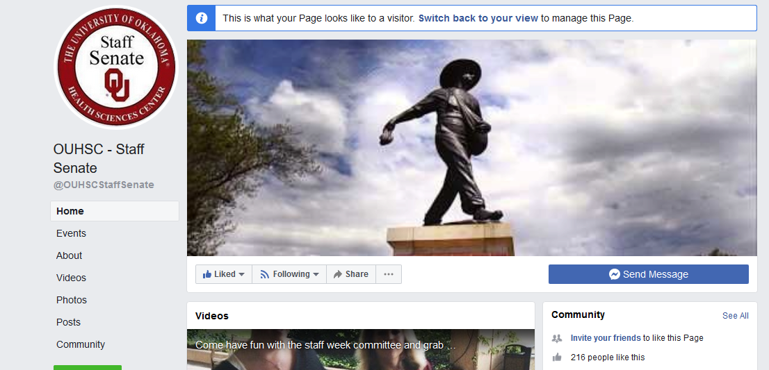

Share
Tag
Follow
LIKE
OUHSC - Staff Senate
@OUHSCS
@ouhscstaffsenate

Slide 23
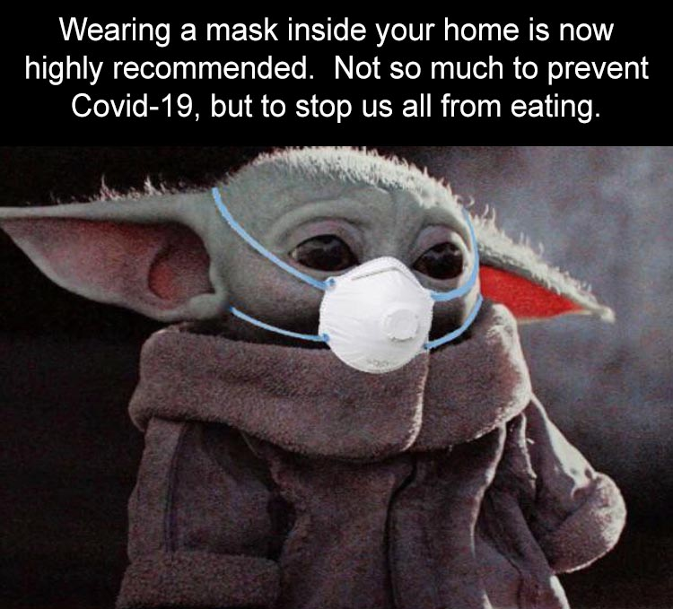
Building CommUNITY
You Matter. Get informed. Get Involved. Staff Senate
This presentation will be posted on our website
Ouhsc.edu/staffsenate/ under the news and events link.

