Slide 1

2021 BeNEFITS
Lee Camargo-Quinn
HR Assistant Director, Benefits

Slide 2
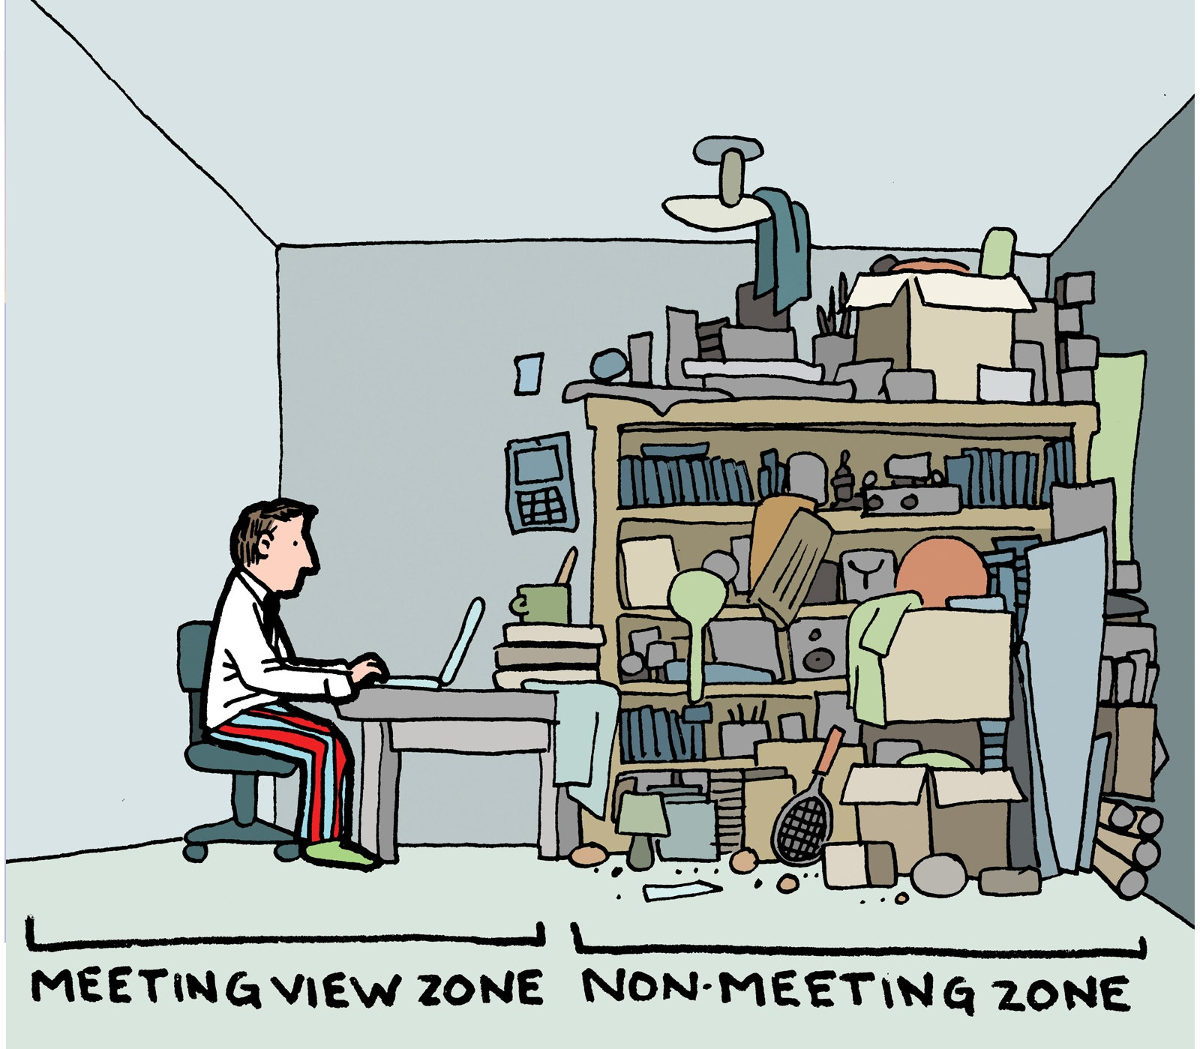
Staff Senate Meeting
September 3, 2020

Slide 3
OUHSC Staff Senate
Business
Call to Order time
Quorum?
June and August Minutes will be sent to Senators for approval via email

Slide 4
Executive committee Treasurer’s Report
Report Pending
Due to the upgrade of PeopleSoft system, our July report is still open. The previously approved/shared report can be found on the Staff Senate Website.
2020-2021 Meeting Archive- June 18th 2020 minutes

Slide 5
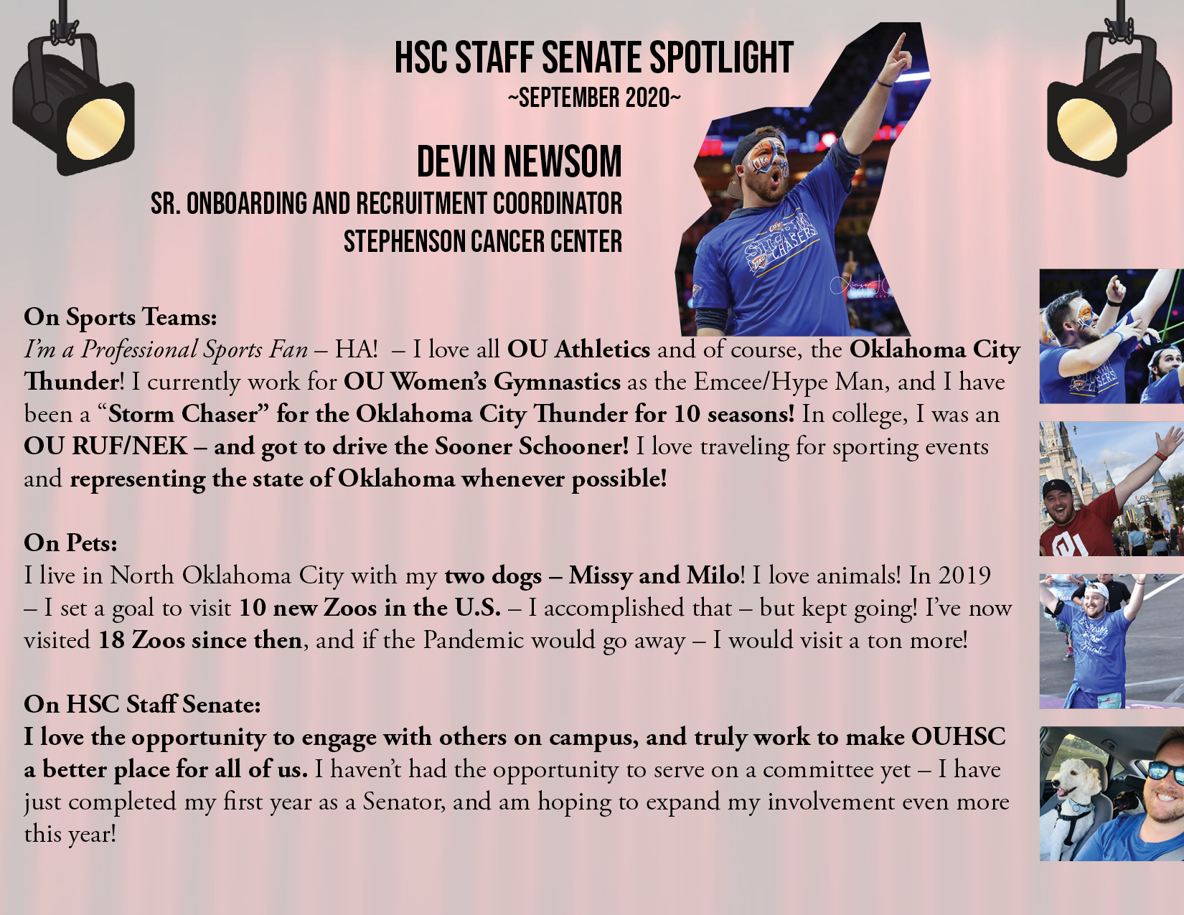
Staff Senate Spotlight- add here

Slide 6
Committee on committees
We had an amazing response with our committee interest forms. At this time, all committees have full rosters.
Senator report
1 current vacancy – College of Nursing
1 current vacancy- College of Medicine
Carol Clure 271-2054 Carol-Clure@ouhsc.edu
Will Andrews x36121William-Andrews@ouhsc.edu

Slide 7
Communication committee
Meetings will be held on the 3rd Thursday of each month.
First meeting of the year will be on September 17th

Slide 8
Community outreach committee
Meet the 4th Tuesday of every month from 10-11am
Virtual meetings indefinitely by Zoom
We held our first meeting last week to get to know our new members. We more than doubled our committee size with new members.
We’ll be deciding, as a group, at our Sept meeting what projects we will do or entities we will support this year. Stay tuned for more information
Please continue to save pop tabs and coupons for Troopons!
“Troopons” are the Manufacturer’s Coupons for our Overseas Troops
*Special Thanks to our committee chairs- Kyndall Wahkinney and Jennie Robison who have continued their committees/community support throughout the pandemic shutdowns.

Slide 9
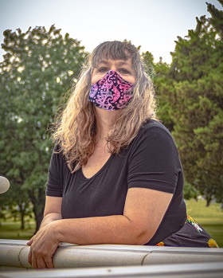
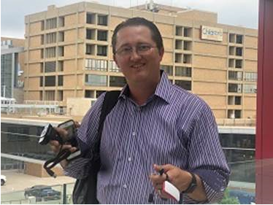
Employee of the Month
July 2020
Anthony Mount
College of Medicine,
Office of the Dean
September 2020
Sarah Harris
College of Medicine, Urology

Slide 10
Employee of the month committee
Eligibility- FT, Non faculty appt. Worked at least 5 consecutive calendar years.
3 letters of support from OUHSC personnel (one from direct supervisor)
Nominee must not have received the Employee of the Month award in the past five years.
Complete eligibility and details can be found on our Staff Senate website.

Slide 11
Fundraising COMMITTEE
Committee meets the last Wednesday of the month at 10:30am. This months meeting held via ZOOM. Future in person meetings TBA.
August meeting outlined prospective projects for the upcoming year. WE WELCOME YOUR IDEAS!
Our first fundraiser for the 20/21 school year will be Bedlam T-shirt Sales. Tentative launch date for fundraiser is September 11th.
Special Thanks to Paul Cockrell who organized the Virtual Paint Event in late July. It was a great success!

Slide 12
Staff EVENTS Committee
Pending report from Leslee Smith and Danielle Doshier

Slide 13
New business and announcements
THE FOLLOWING SLIDES ARE THE UPCOMING EVENTS FOR OUHSC
IF YOUR DEPARTMENT WOULD LIKE AN EVENT FEATURED HERE – PLEASE EMAIL Nancy-Geiger@ouhsc.edu

Slide 14
The Outpace Cancer Race is Going Virtual
The Outpace Cancer Race, hosted by Stephenson Cancer Center, is historically a 10K/5K run and 1-mile walk at which family and friends come together to raise funds for cancer research as well as patient and family support.
This year, the Outpace Cancer Race has transformed from a one-day event into a month-long virtual fitness challenge. Throughout September, we’re encouraging participants to walk, run or bike in memory of those who have lost their battle with cancer and in dedication to those who continue to fight.
Participants will register at outpacecancer.com and then have the opportunity to create or join a fundraising team as well as log their miles during September.

Slide 15
Human Resources
Financial/Retirement Planning with Fidelity now available. Schedule your virtual appointment by calling (800)642-7131. or go to NetBenefits.com/Sooners to book an appointment.

Slide 16
SHARED LEAVE
Donation Eligibility
You may donate any amount so long as your remaining Paid Leave Balance is at least 50% of your Annual Accrual Rate.
If you have someone in your department that rolls over hours consistently to their extended leave, please consider providing them an application
It is a selfless act to help a fellow employee in dire need – even one hour helps

Slide 17
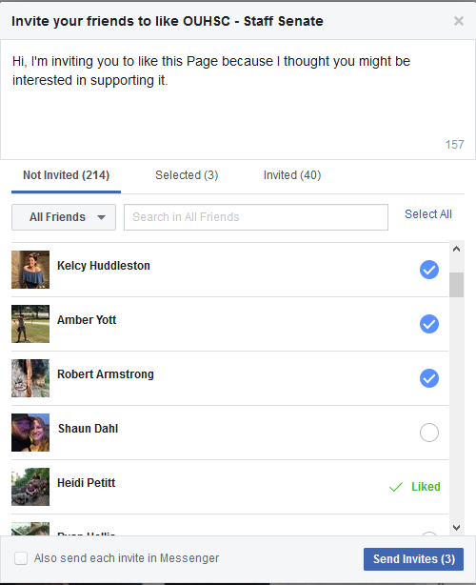
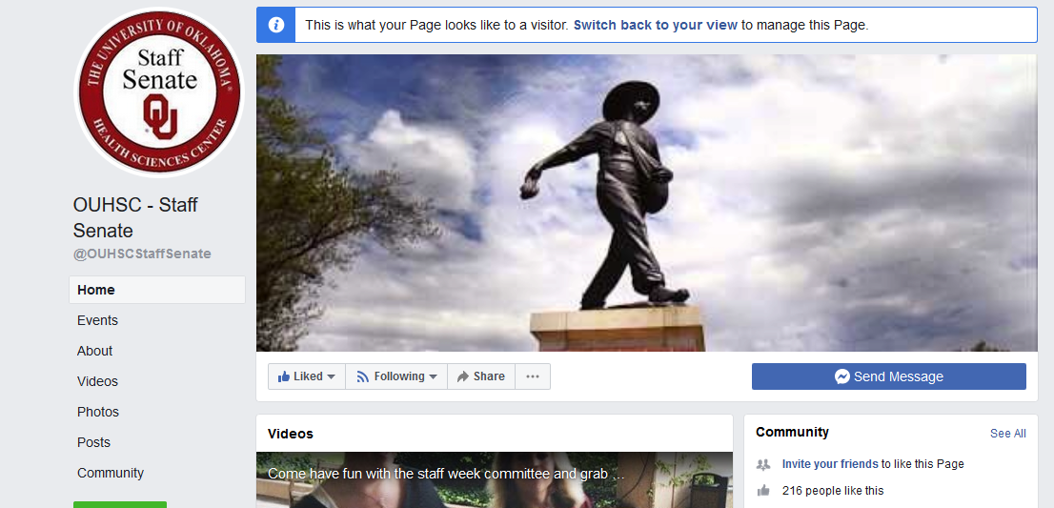
HELP US GET MORE FB FRIENDS!!
Click “Invite your friends”
Select Friends and Click “Send Invites”
IT IS THAT EASY!!

Slide 18

Building CommUNITY
You Matter. Get informed. Get Involved. Staff Senate

Slide 19

Don’t forget to follow us on social media!
OUHSC - Staff Senate
@OUHSCS
@ouhscstaffsenate
OUHSC - Staff Senate
@OUHSCS
@ouhscstaffsenate

