Slide 1
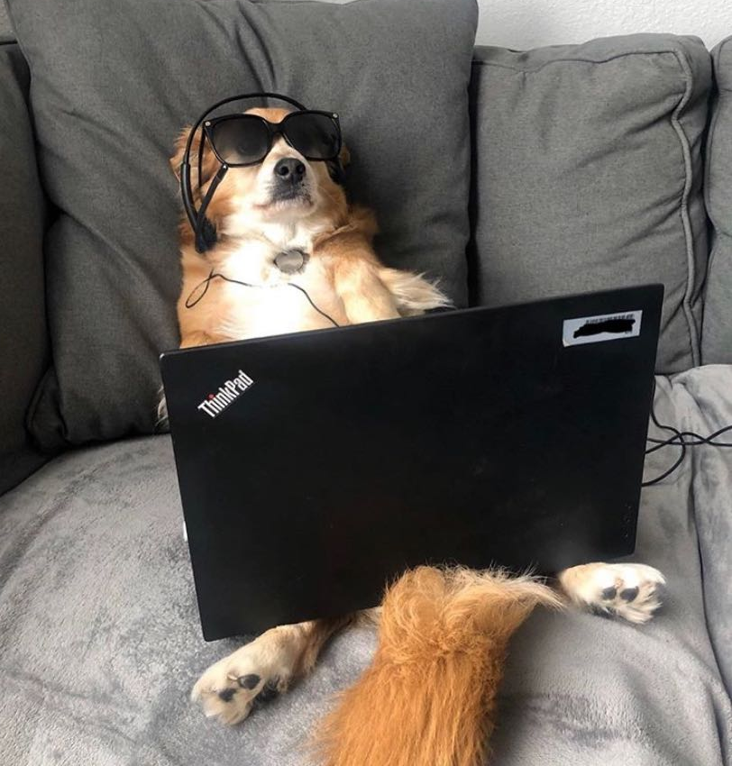
Staff Senate
Meeting
November 5, 2020

Slide 2

Please mind your mute…

Slide 3
“Veterans Helping Veterans”
ALFRED HOLLIS, fmr. U.S. Air Force & Strategic Air Command
Chair/ Veterans Corner
Alfred Hollis served in the US Air Force and spent 4 years in an Air Police Unit. He served on an air
security team of the 62nd 51st combat support group at Bien Hoa, Air Base, Vietnam in 1970.
He served in the Strategic Air Command (SAC) which was a very strict and disciplined duty at Vandenburg AFB and was a missile base on the coast of California. He completed AZR Jungle training at Camp Bullis, Texas before deploying to Vietnam. Alfred was discharged at Tinker AFB in 1972. While at medical technology provider Hill-Rom he received numerous prestigious Area, Regional and National awards for his outstanding performance in management and for having no financial waste.

Slide 4
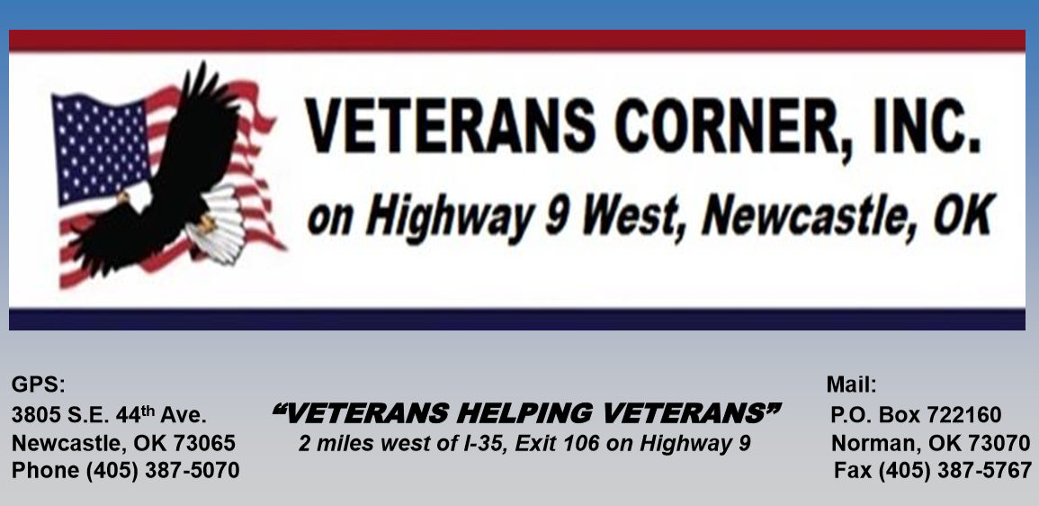

Slide 5
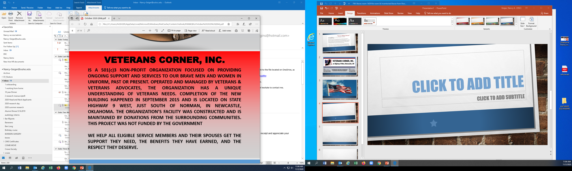


Slide 6
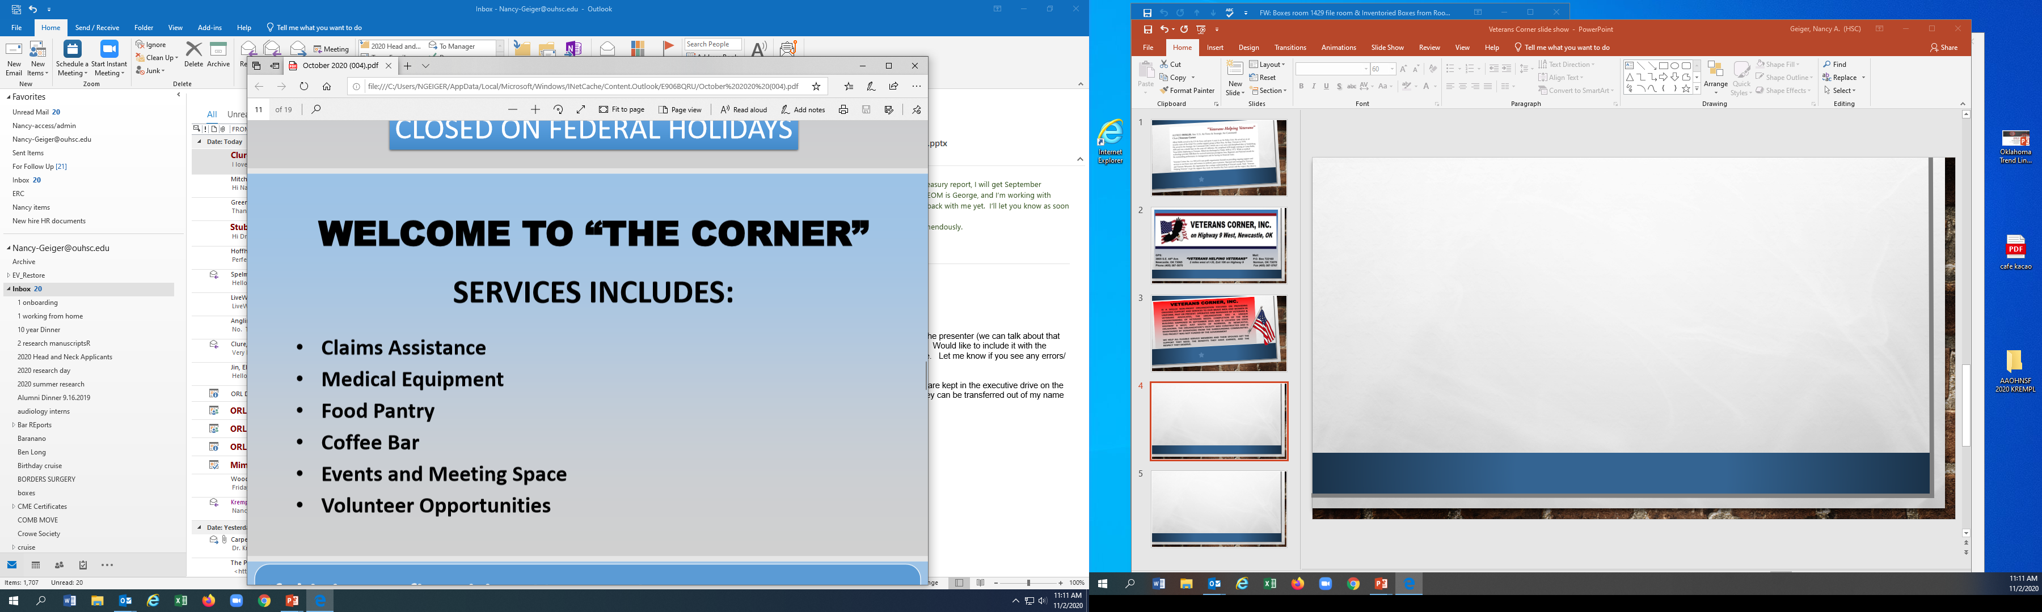
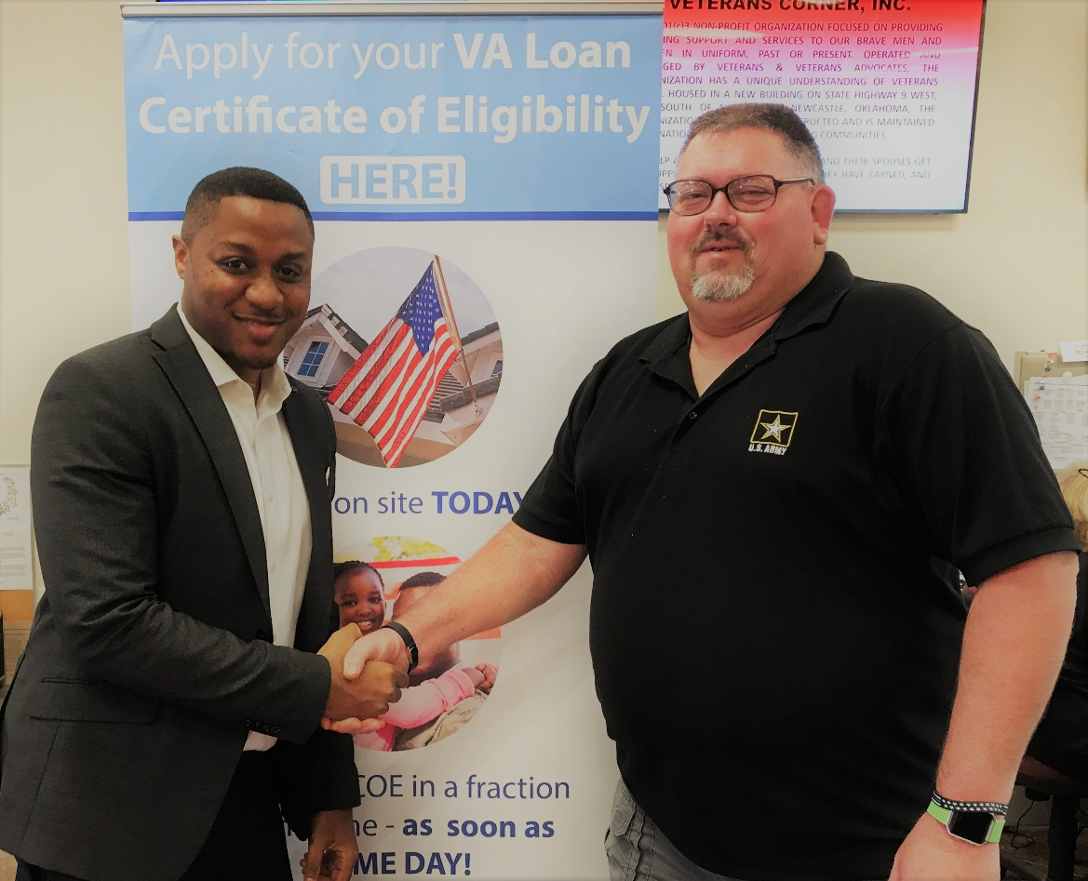

Slide 7
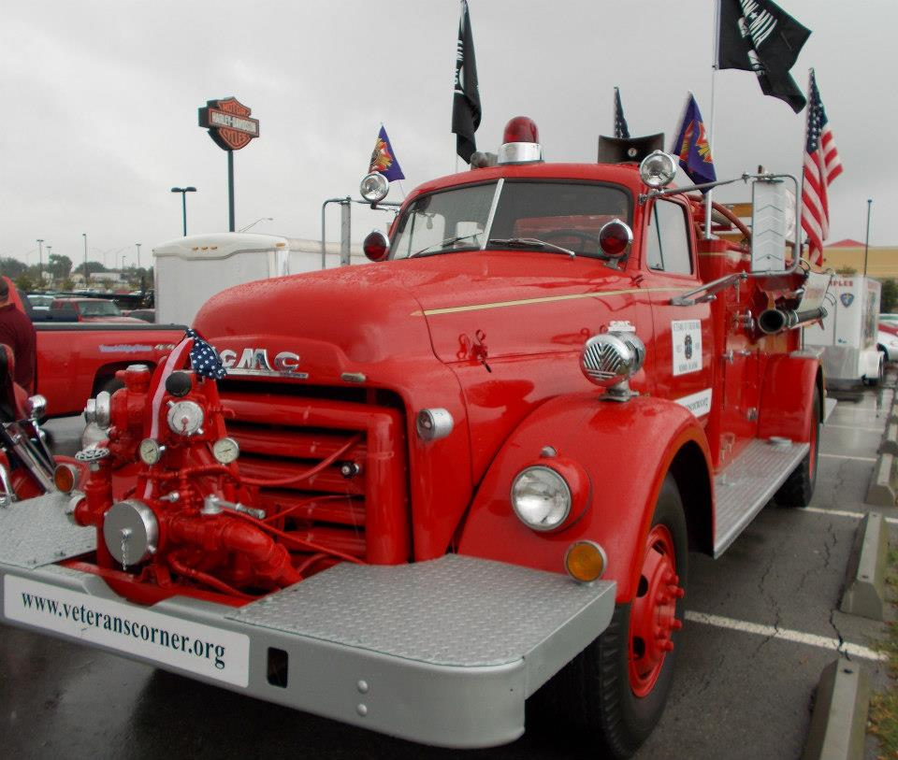
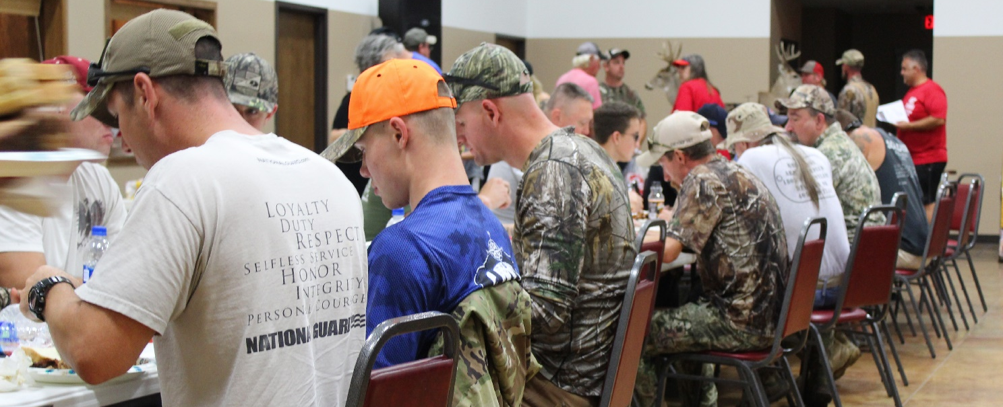
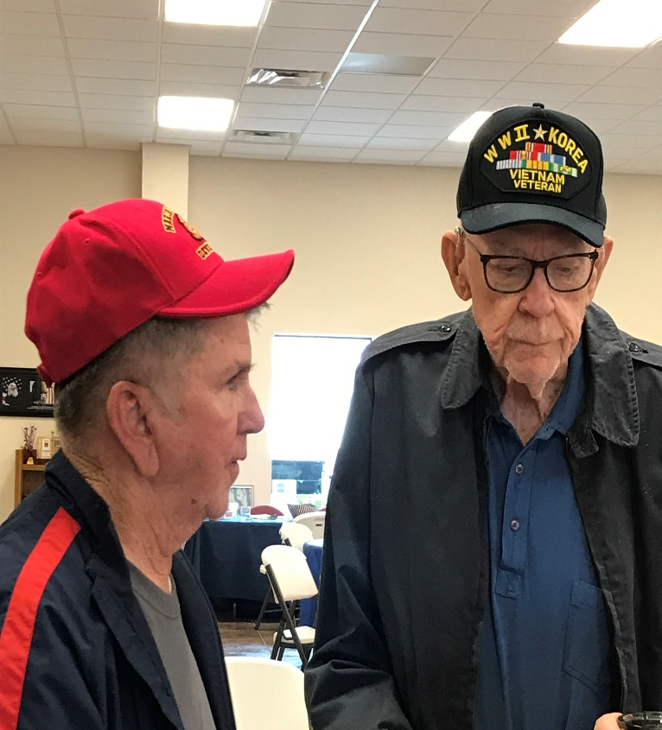
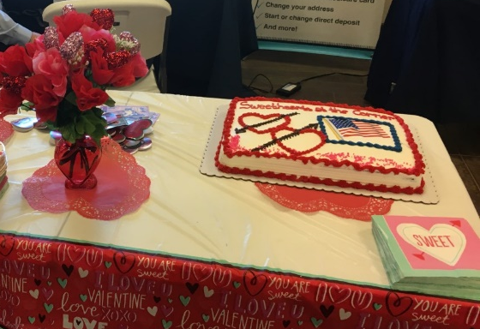
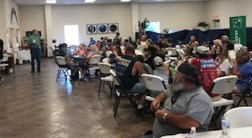
DOVE HUNT 2018
Valentines Day
Poker Run
EVENTS at Veterans Corner

Slide 8
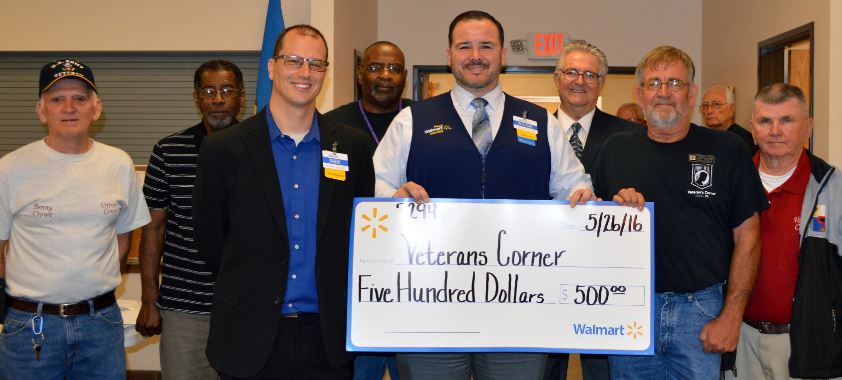
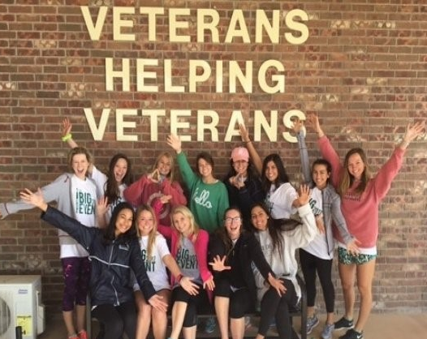
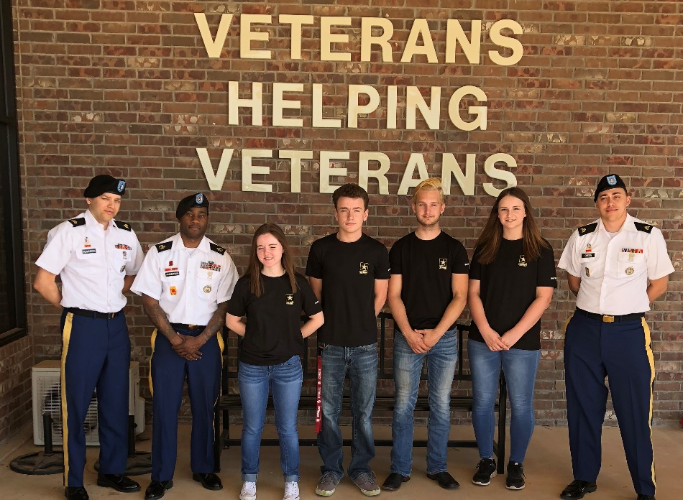
OU Big Event Week
Support from our community

Slide 9
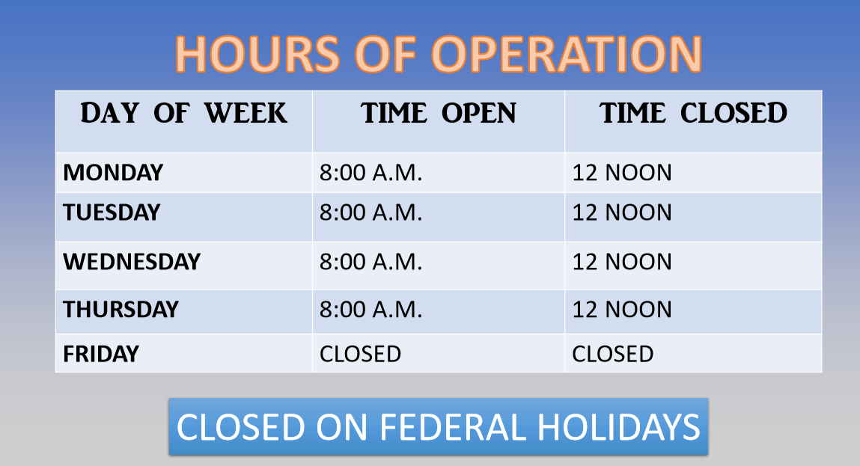
Veterans Corner, Inc. Is currently closed due to public health concerns. However, help is still available. If you need help filing a claim, contact the ODVA at (405)523-4000.

Slide 10
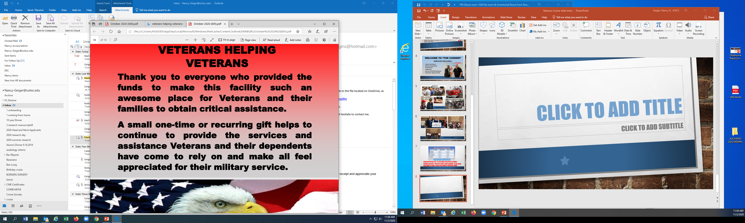

Slide 11
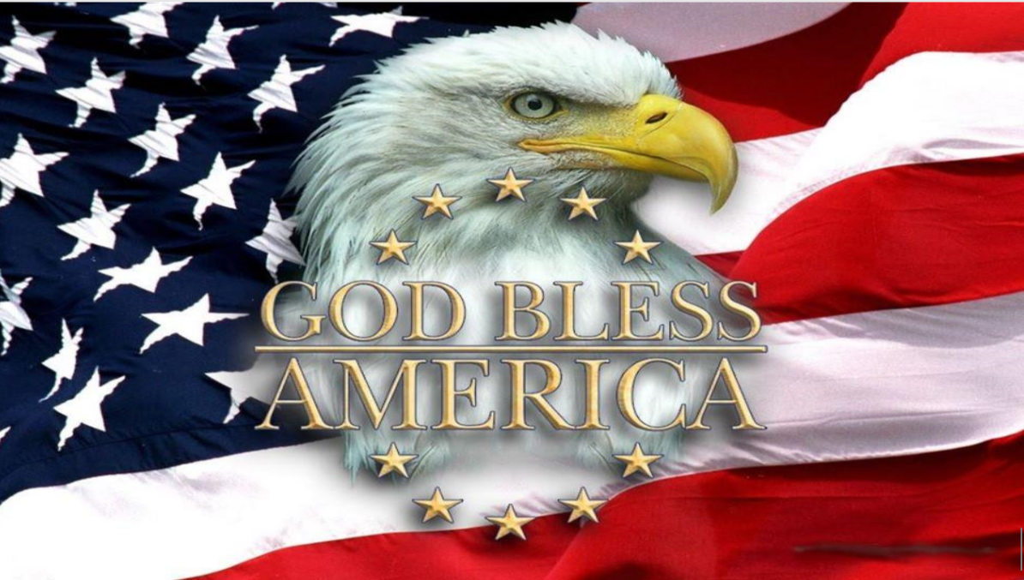

Slide 12

Please contact Angelique-price@ouhsc..edu to RSVP by November 8th

Slide 13
OUHSC Staff Senate
Business
Call to Order time
October Minutes will be approved
via email for Senator Vote and posted on our Staff Senate webpage
www.ouhsc.edu/staff senate

Slide 14
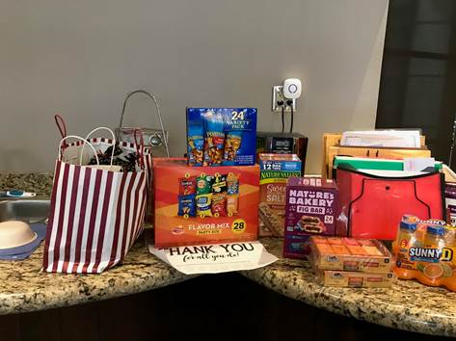
Community outreach committee
In October we highlighted two organizations on campus- Employee Health and Parking and Transportation for their service, especially during the pandemic. Bags of snacks and candy were collected and distributed to show our appreciation.
Next month: A partnership with the Child Study Center to collect backpacks and fill them with activity books, puzzles, small games, markers, socks, snacks, etc.
These will be distribution to foster children they work with. Please contact Jennie-Robison@ouhsc.edu or Kyndall-Wahkinney@ouhsc.edu if you would like to help. Donated items are requested by November 24th.

Slide 15
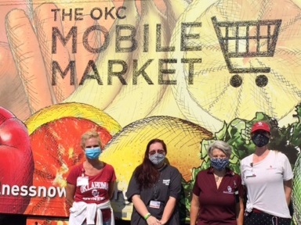
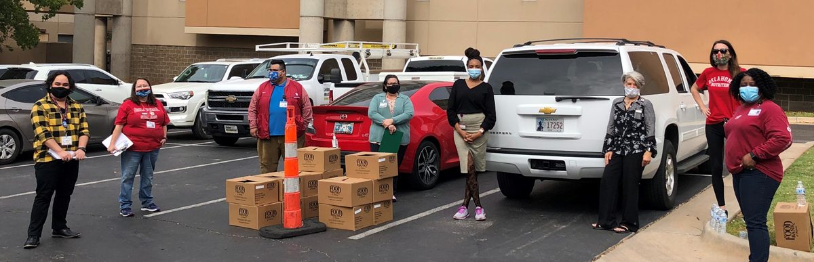
Thank you Community Outreach Committee Volunteers for supporting the Mobile Market Distribution Sites in the Month of October.

Slide 16
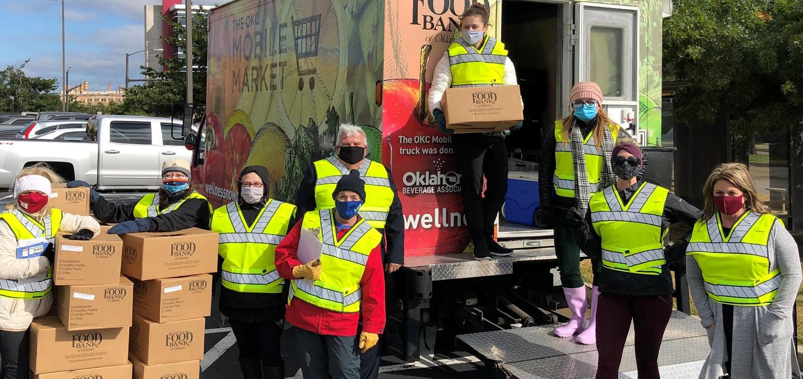
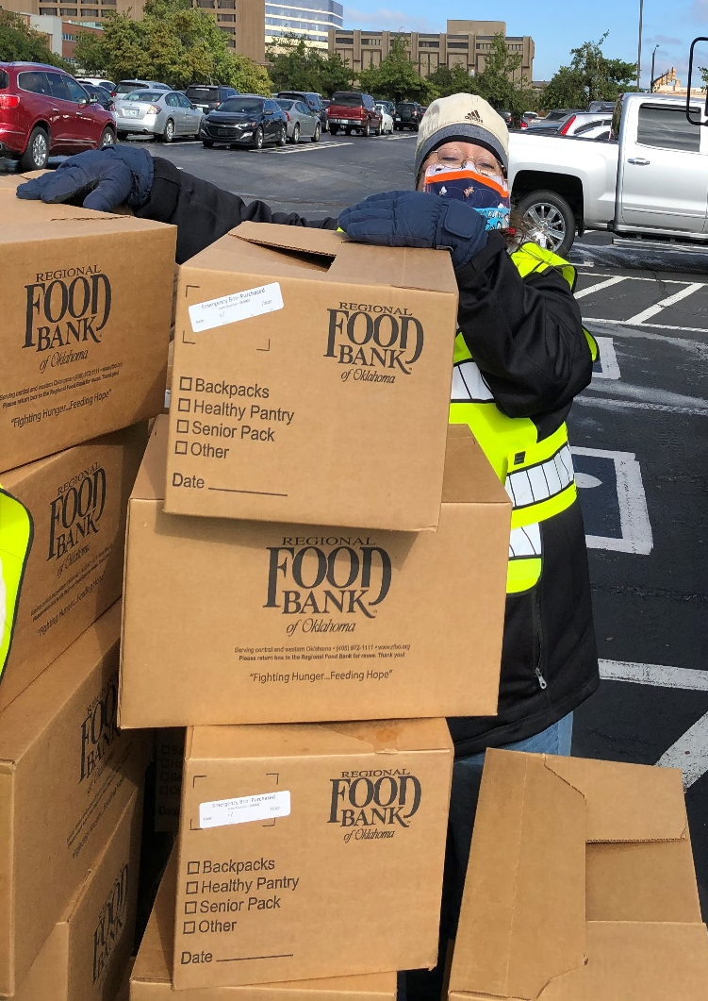
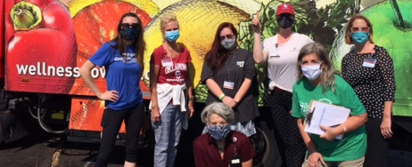
Mobile Market Volunteers
Distributed 600 boxes in October

Slide 17
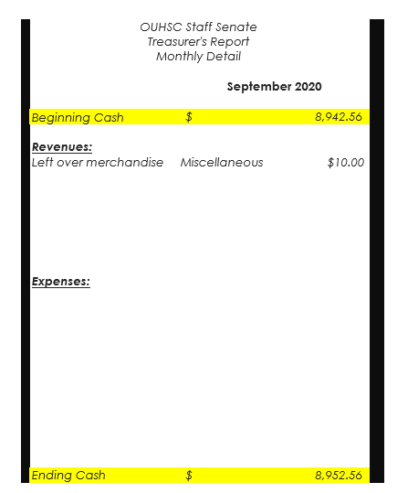
Executive committee
Treasurer’s Report
August Report – NO activity
September Report-
Out to Senators for vote
DRAFT
2020-2021 Meeting Archive-
For previous minutes

Slide 18
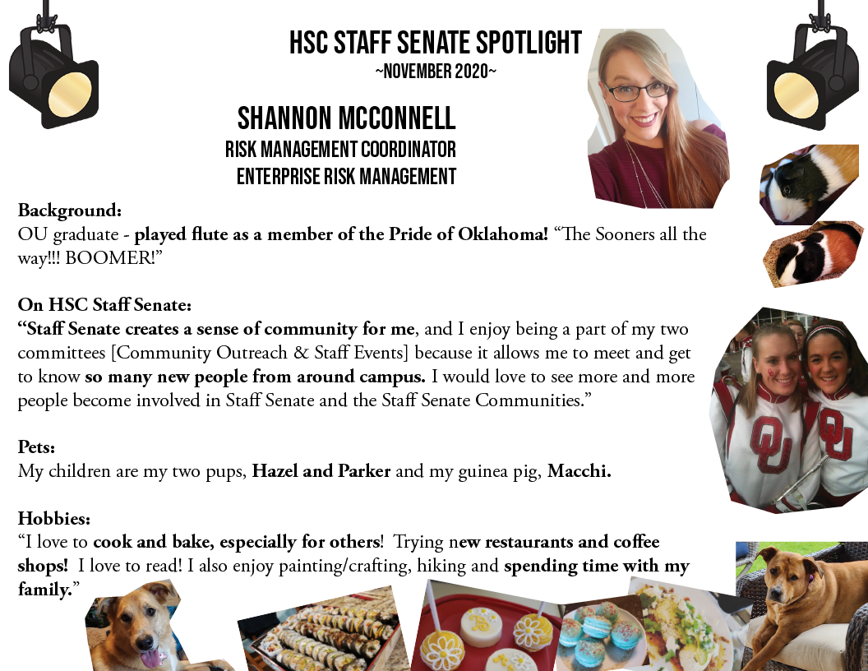

Slide 19
Committee on committees
At this time, all committees have full rosters.
Senator report
1 current Senator vacancy- College of Medicine
Executive Committee
1 current Vacancy- Chair Elect -2021/Chair 2021-2022
Carol Clure 271-2054 Carol-Clure@ouhsc.edu

Slide 20
Communication committee
Communication Committee met via zoom on October 15th.
They are currently working on options for a newsletter format as well as promotional materials.
The HSC Communication Committee will continue to be the point for updates to social media, the HSC Staff Senate website, and email. The team works with other SS committees to highlight the efforts, events, outreach, and updates related to HSC Staff Senate. For the latest Staff Senate Updates, follow them at:
Facebook.com/OUHSCStaffSenate
Meetings will be held on the 3rd Thursday of each month.

Slide 21

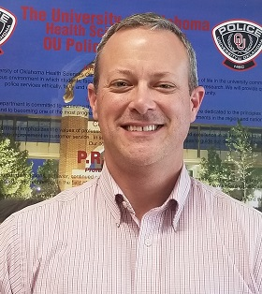
Employee of the Month
November 2020 EOM
Captain George Schmerer
University of Oklahoma Police Department- HSC Campus

Slide 22
Employee of the month committee
Eligibility- FT, Non faculty appt. Worked at least 5 consecutive calendar years.
3 letters of support from OUHSC personnel (one from direct supervisor)
Nominee must not have received the Employee of the Month award in the past five years.
Complete eligibility and details can be found on our Staff Senate website.

Slide 23
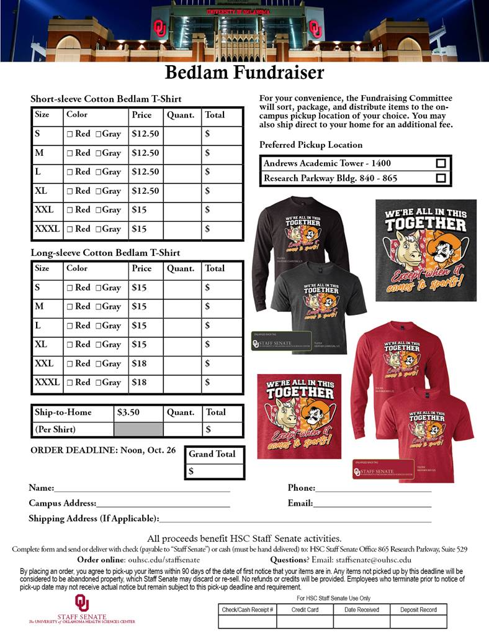
Fundraising COMMITTEE
  Holiday Fundraisers Launched in October-
  See’s Candies are available & include home delivery
  option until December 4th
ouhsc.edu/staffsenate
  Bedlam T-shirt sales ended- 350 sold
  Crockstar Dinner sales ended
The funds raised from these sales will support Staff Senate events on our campus. Please support these generously.
We are also working with OU Tulsa to collaborate on future fundraisers.
Committee meets the 4th Wednesday of the month at 10:30am via ZOOM. Also does business via email.

Slide 24
Staff EVENTS Committee
Due to the ice storm, our October Pumpkin Decorating was cancelled for October 28, 29 & 30th.
Fall Craft Making event will be held next week on Thursday, November 12th. Details will be sent out later this week. Please watch your email for details.
This committee meets the 3rd Wednesday of the month via ZOOM

Slide 25
New business and announcements
THE FOLLOWING SLIDES ARE THE UPCOMING EVENTS FOR OUHSC
IF YOUR DEPARTMENT WOULD LIKE AN EVENT FEATURED HERE – PLEASE EMAIL Nancy-Geiger@ouhsc.edu

Slide 26
Educational and family task force
In partnership with OUHSC, OU Medicine, St. Luke's and Regional Food Bank of Oklahoma, we launched a Mobile Market available to all members of the OU community. This Mobile market will distribute Food Packs on Thursdays in designated campus locations.
Our Community Outreach Committee and Staff Senate Volunteers staffed all dates/October volunteer slots. 600 Food Pantry Boxes were distributed. Shout out to all those who have volunteered time to help our OU families.
Mobile Market Initiative will conclude in Mid December. November will be manned by Student Senate Volunteers. If you would like to volunteer in December, please contact Kelli Walsh Kelli-walsh@ouhsc.edu

Slide 27

2021 BeNEFITS
Open Enrollment Closes tomorrow
November 6, 2020

Slide 28
Human Resources
Financial/Retirement Planning with Fidelity still available. Schedule your virtual appointment by calling (800)642-7131. or go to NetBenefits.com/Sooners to book an appointment.

Slide 29

Angels are ready for adoption
The 14th Annual OU Health Physicians Angel Tree Project Kicked off in October.
Pick an ornament of the tree (or they can scan to you)
Purchase the items on the list and return them unwrapped to the Executive office on or before Dec 2nd.
All gifts are confidentially distributed to the angel’s parents.
Sign out an Angel Ornament selected from the tree. Or contact Kathy-Hoffhines@ouhsc.edu to request a scanned copy of a list. Monetary donations are also welcome.

Slide 30


Slide 32
On-Campus Health Screenings Available
Blood Pressure/InBody Body Composition/Blood Glucose/Cholesterol
On-campus health screenings are available at no out-of-pocket expense to OU employees covered by the OU BCBS plan. If you do not have insurance through OU and would still like to participate, the health screening team can process alternative insurance. Please note, any amount not covered by your non-OU insurance plan will be billed to the patient.
COVID-19 policies will be strictly adhered and enforced. Employees from any campus can make an appointment. Health Screenings do not test for COVID-19.
Email CHWBiometricScreening@ouhsc.edu to schedule an appointment
OUHSC Dates
Nov. 4 & 24 from 7 AM – 1 PM: OU Children’s Physicians Bldg., Conf. Room 9895
Nov. 10 from 8:30 AM – 1:30 PM: Nicholson Tower, Conf. Room F
Nov. 12 from 7:30 AM – 1 PM: O’Donoghue Bldg., ORI 252
Nov. 19 from 8:30 AM – 2 PM: Bird Library, Faculty Atrium

Slide 33
PIN: 2020

Slide 34



Staff Senate…
Find us!
OUHSC-Staff Senate
@ouhscstaffsenate
@OUHSCS

Slide 35

Building CommUNITY
You Matter. Get informed. Get Involved. Staff Senate
Next meeting- Thursday,
December 3rd at 10am via Zoom

