Slide 1
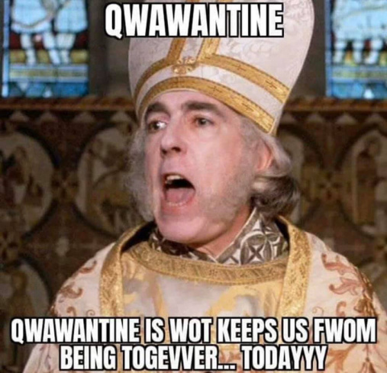
Staff Senate
Meeting
March 4, 2021

Slide 2


Please use your mute button
We invite you to add your questions into the chat.

Slide 3

FEATURED SPEAKER

Slide 4
OUHSC Staff Senate
Business
Call to Order time
January minutes and Treasurer report approved via email and can be found on the Staff Senate webpage.
www.ouhsc.edu/staff senate

Slide 5


Community outreach committee
YOUR HELP IS NEEDED! We are collecting, cutting and sorting Manufacturers coupons for our overseas troops and their families.
Collect/cut out your coupons (including any expired up to 3 months) and send. Sort coupons: Food items/non-food items/baby food/pet items
      Coupons can be sent via campus mail to:
        ERM
        C/O Community Outreach Committee
        Research Park 865, Suite 520
        Deadline: March 12th
Please contact Jennie-Robison@ouhsc.edu or Kyndall-Wahkinney@ouhsc.edu if have any questions.

Slide 6
Staff Senate Spotlight

Slide 7
Committee on committees
At this time, all committees have full rosters.
Senator report
2 current Senator vacancy- College of Medicine
Carol Clure 271-2054 Carol-Clure@ouhsc.edu

Slide 8
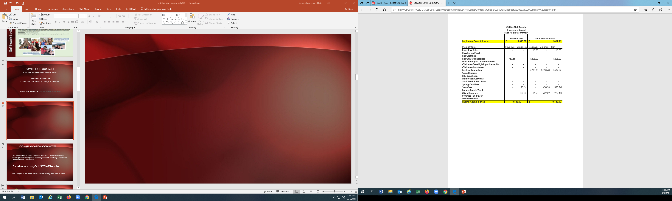

Slide 9
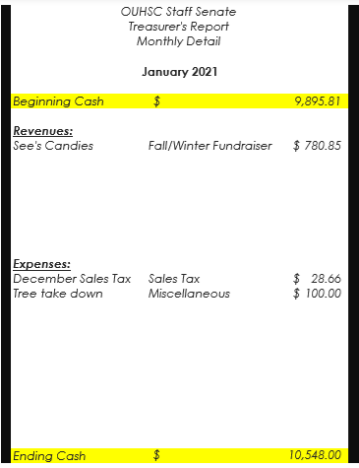

Slide 10
Communication committee
HSC Staff Senate Communication Committee met to collectively review promotion requests, including for the Fundraising Committee and Outreach Committee.
Facebook.com/OUHSCStaffSenate
Meetings will be held on the 3rd Thursday of each month.

Slide 11

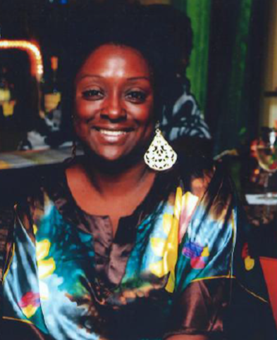
Employee of the Month
MARCH 2021
Kenyatta “Michelle” Williams
Laboratory Support Technician
Microbiology & Immunology

Slide 12
Employee of the month committee
Eligibility- FT, Non faculty appt. Worked at least 5 consecutive calendar years.
3 letters of support from OUHSC personnel (one from direct supervisor)
Nominee must not have received the Employee of the Month award in the past five years.
Complete eligibility and details can be found on our Staff Senate website.

Slide 13




Slide 14


Staff EVENTS Committee
Staff Events committee meeting March 2nd. Will provide update following the meeting.
STAFF

Slide 15

Employee recognition Committee
Our Annual Employee Recognition
Will be held this year in April as a virtual Event.
Award Recipients should have received communication via email.
More details to follow soon…

Slide 16

New business and announcements
THE FOLLOWING SLIDES ARE THE UPCOMING EVENTS FOR OUHSC
IF YOUR DEPARTMENT WOULD LIKE AN
EVENT FEATURED HERE PLEASE EMAIL Nancy-Geiger@ouhsc.edu

Slide 17

VOLUNTEERS NEEDED:
OU Health is seeking volunteers for their upcoming 65+ COVID-19 Vaccine Clinics. Opportunities to sign up through March are available.
VOLUNTEER ROLES:
Clinical Volunteers - College of Medicine:
Vaccinate and monitor patients. The Clinical Volunteers require documented training.
Clinical Volunteers - OU Health: Vaccinate and monitor patients. The Clinical Volunteers require documented training
Administrative: Check in patients via the database system and document their vaccination status.
Runners/Greeters: Support administrative/organization/wayfinding needs during the clinic.
Please direct questions to Kyli Fitzgerald, OU Physicians, at Kyli-Fitzgerald@ouhsc.edu.

Slide 18


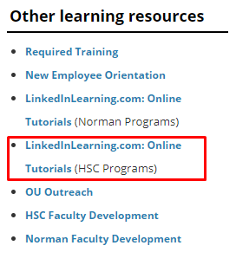
The OU HR Learning and Organizational Development Team (L&OD) is offering some really great resources via our online platform! These online classes are not only tailored to fit our remote working situation, but some of them also address our current world events involving COVID-19.
Visit the OU Training Calendar and click on the Online tab to see all the available classes. All classes are shown for the campus on which you normally work. apps.hr.ou.edu/ClassCalendar
Check out some of their current classes:
Emotional Intelligence (part 1 and 2)
Employee Engagement: Fundamentals, Impact, and Strategies
Effective Delegation (Part 1) Delegating vs Abdicating
Employee Engagement: 5 Generations in the Workplace
Health Conflict I: Disagree in a Healthy Manner
Linked In Learning: On-Demand Learning
https://hr.ou.edu/Employees/Career-Development/Learning-Development
Issues:
servicedesk@ouhsc.edu

Slide 19

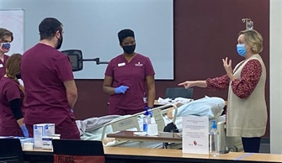
OU College of Nursing Received an Anonymous $2 million Gift!
This generous donation will anchor funding for an expansion of facilities for our simulation clinic, including an acute care simulation center, a clinical assessment lab, and a universal-design apartment home to support nursing education at all levels.
Nursing.ouhsc.edu/News

Slide 20
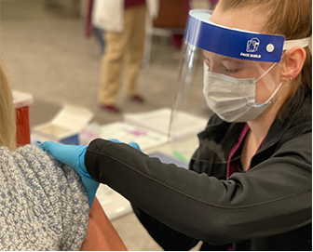

College of Nursing News
The College of Nursing held their 2nd Vaccine Clinic earlier this week on
March 1-2nd. 200 vaccinations were administered to our staff, faculty and students.
Special shout out to our student affairs staff, Jessica Thompson, Gloria Cooper, Kay Locke, Marinda Houck and Mark Gunter for their hard work and contributions to the clinic.

Slide 21


ou.edu/diversity
Upcoming events and training:
March 24th
Pathway to Belonging
12-1:30pm
March 8th
International Women’s Day Summit
11a-5p
March 22-26th
Diversity, Equity & Inclusion Week
March 29
12-1pm / Brown Bag Book Club
I'm Still Here: Black Dignity in a World Made for Whiteness
Sign up required

Slide 22

We appreciate and recognize the amazing staff on our campus who have done their part to combat Covid-19 since the beginning. This month, the Academy of Teaching Scholars recognized many HSC staff members the Education Hero Award.
The Education Hero award recognizes faculty and staff whom through hard work, dedication, and excellence support and advance the efforts of the College of Medicine. Congratulations! And thank you for your hard work. A list of the winners are available here: https://medicine.ouhsc.edu/Faculty-Staff/Academy-of-Teaching-Scholars/Recognition-and-Awards/Education-Hero-Award

Slide 23
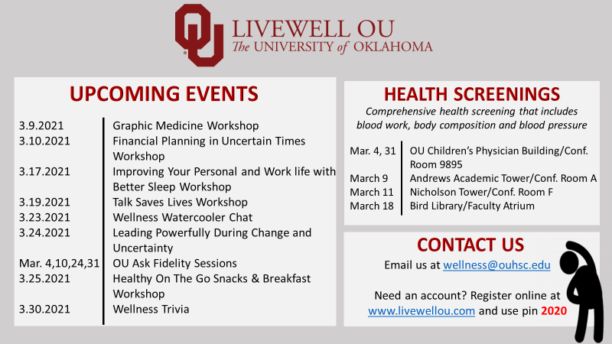

Slide 24



Staff Senate…Find us!
OUHSC-Staff Senate
@ouhscstaffsenate
@OUHSCS

Slide 25
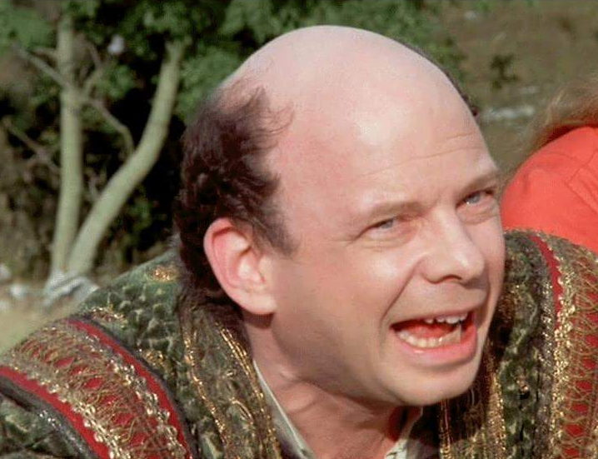
OUR MEETING IS OVER?
Next Staff Senate Meeting
Thursday, April 1, 2021
10am
INCONCEIVABLE

