Slide 1
HR Learning & Development
HSC Staff Senate
March 4, 2021

Slide 2
THE Tri-campus Team!
Jeffery Cooper, PhD – Associate Director of Learning & Development
  jeffery-cooper@ouhsc.edu
Facilitation Team:
  Angela Russell – angela-Russell@ouhsc.edu
  Jeri Stroup – jeri-stroup@ouhsc.edu
  Melanie Adams – melanieadams@ou.edu
  Nicki Bond – nicki-bond@ouhsc.edu
  Rodney Westbrook – rwtenor@ou.edu
General contact email – learninganddevelopment@ouhsc.edu

Slide 3
2020 Recap
10,000 associates+ attended Zoom workshops for their personal and professional development
1,500 hours+ of online workshops were available staff development
52 workshops were created for the new Zoom environment
8 new compliance courses were created and launched on the OnPoint Learning Management System
146 new/high-potential leaders enrolled in the New Leader Development program

Slide 4
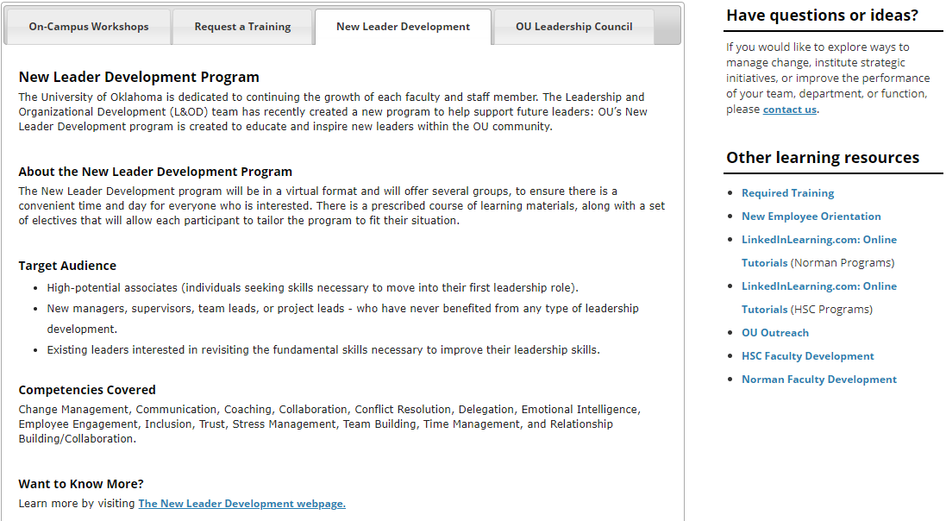
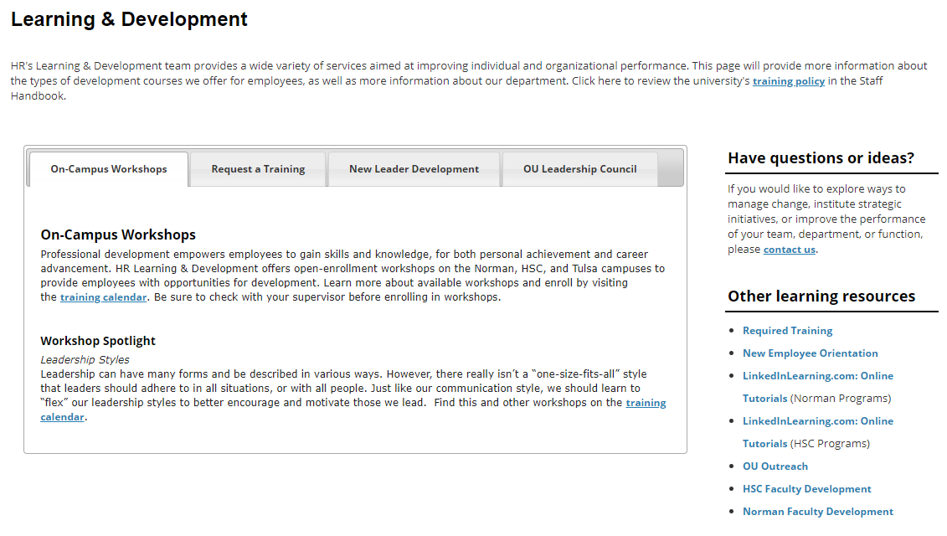
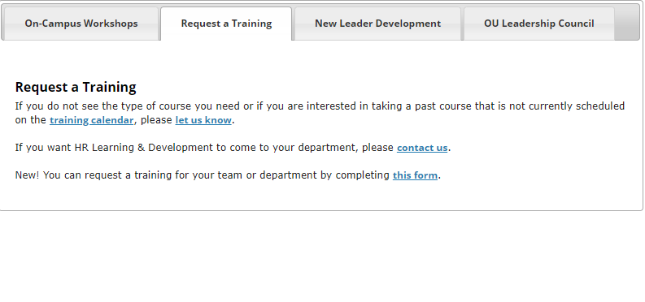
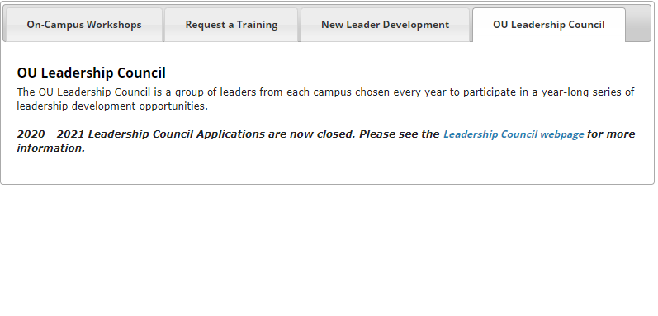
L&OD Webpage
https://hr.ou.edu/Employees/Career-Development/Learning-Development
https://apps.hr.ou.edu/classcalendar/

Slide 5
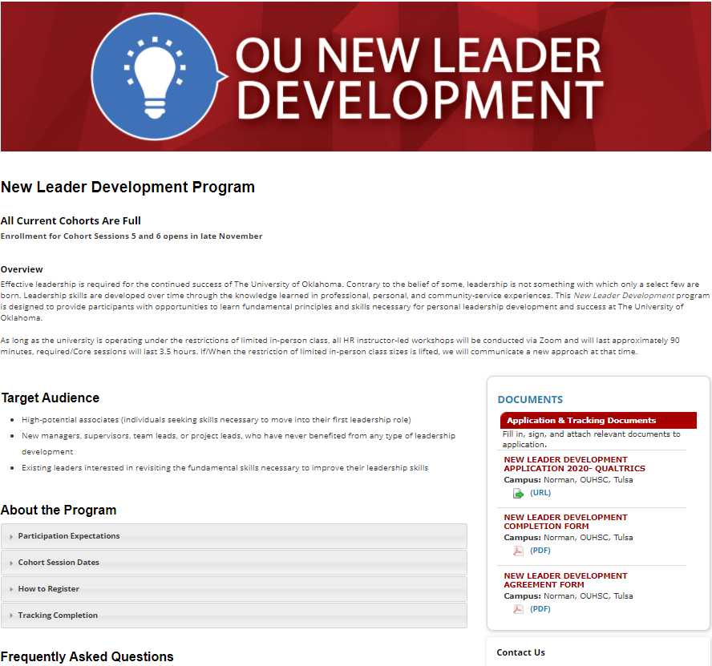
New Leader Development Program
https://hr.ou.edu/Employees/Career-Development/Learning-Development/New-Leader-Development

Slide 6
All workshops currently offered via Zoom
FREE!
Notes:
Performance Planning time for 2021
You don’t have to be in a leadership position to take advantage of a leadership training program… plan for your future!
HR L&OD trainings are to be done during PAID TIME.

Slide 7
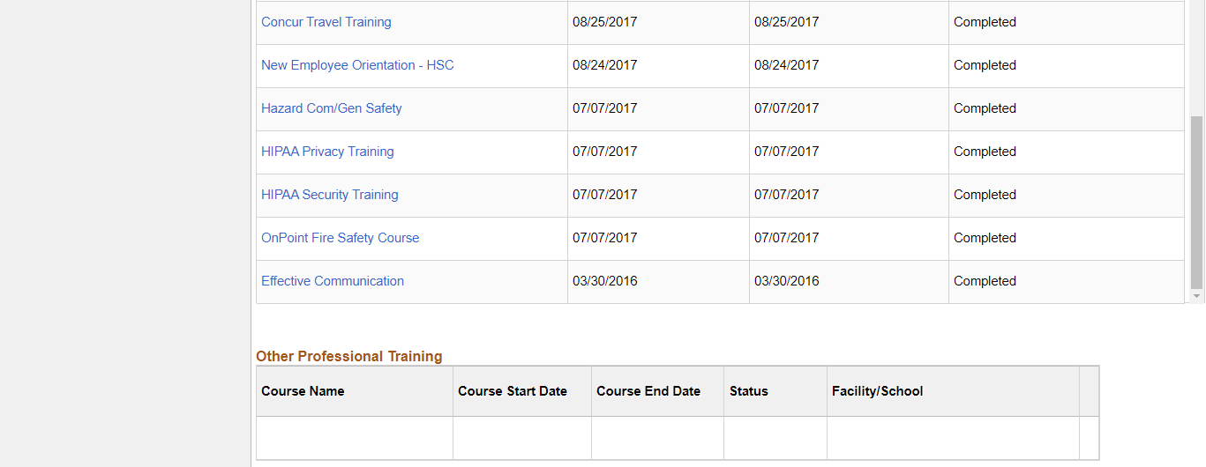
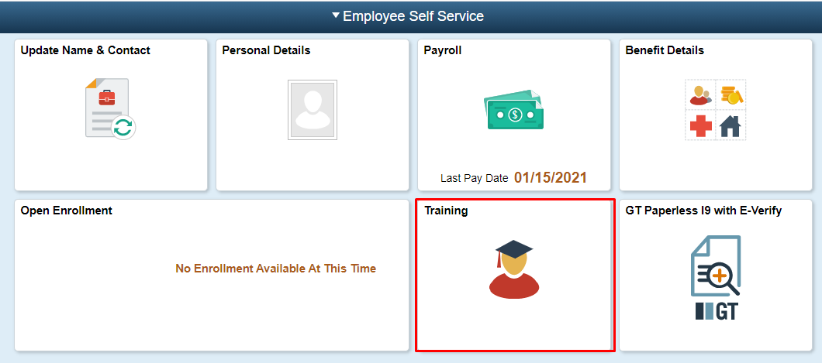
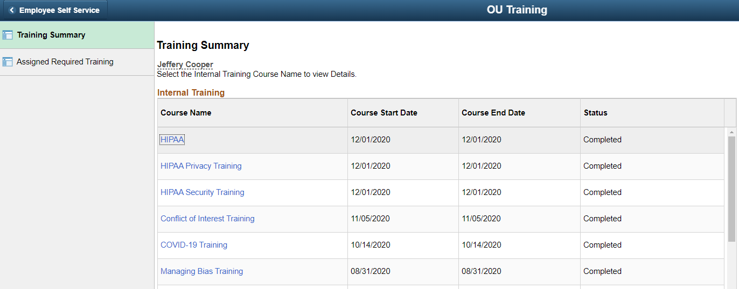
Training Summary
https://selfservehc.ou.edu/

Slide 8
Looking ahead to 2021!
Introducing 10-15 new “general topic” workshops
  Critical Thinking
  Negotiating
  Visual Thinking (re-designed)
  Imposter Syndrome
  Leadership Philosophy
  Professionalism – Part 2

Slide 9
Looking ahead to 2021! Cont.
Introducing a new leadership series: Inclusive Leadership (will need to be currently in a leadership role to participate in this series)
  Changing the Narrative/Why Inclusion Matters
  Competencies and Strategies for Creating Inclusion
  The New Work Culture, and Your Role
  Changing Doers into Leaders
  WHY??? – series by Simon Sinek
  Teambuilding
    DE&I
    Reward and Recognition
    Ice Breakers
    Virtual
  Look for this series in LATE Q3!

Slide 10
Wrap-up
If there is a topic that is of interest to you please share it with us
  learninganddevelopment@ouhsc.edu
Questions???
Final Thought:
  You can read books, you can attend workshops, and you can attend conferences; however, until you USE what you have learned it is all worthless.
Notes:
I will not guarantee it is something we can cover… if we can we will. I also cannot make any guarantee as to WHEN we will get to something. We do NOT provide Office training (utilize LinkedIn Learning for this training)
Outstanding: TAL, I-9s, Performance Management and Evaluations,

